Slide 1

King Cobra
- The King Cobra is the longest venomous snake in the world, reaching lengths of up to 18 feet.
- It primarily feeds on other snakes, including its own species.

Slide 2
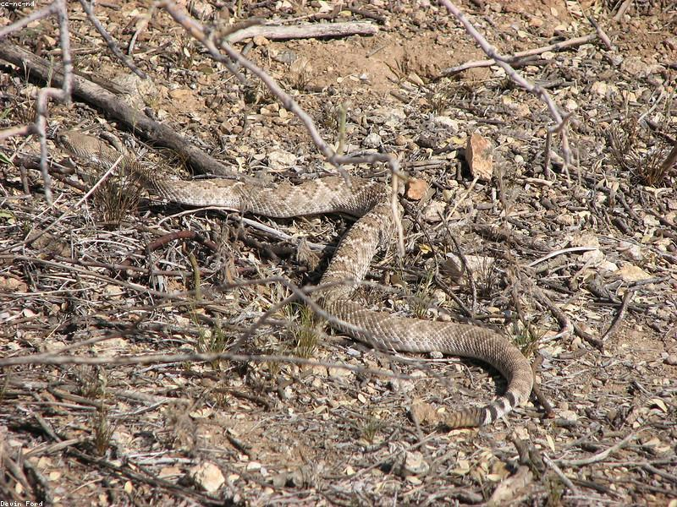
Eastern Diamondback Rattlesnake
- The Eastern Diamondback Rattlesnake is the largest rattlesnake species, known for its distinctive diamond patterns.
- It can be found in the southeastern United States, primarily in pine forests and swamps.

Slide 3
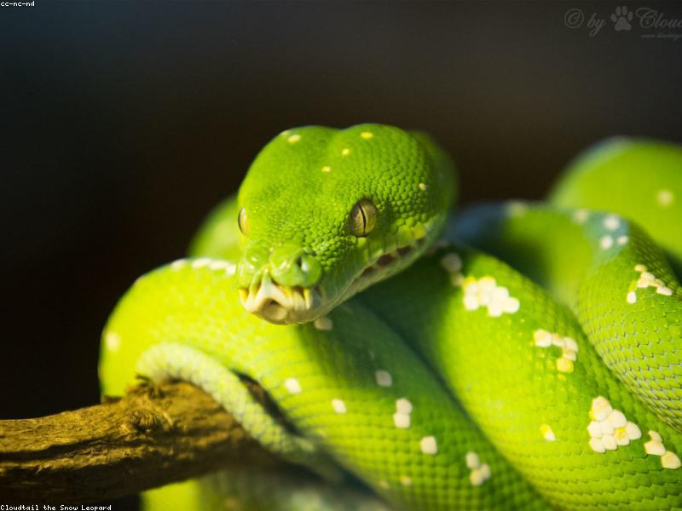
Green Tree Python
- The Green Tree Python is known for its vibrant green color and arboreal lifestyle, often found in trees.
- It is native to New Guinea, Indonesia, and Australia.

Slide 4
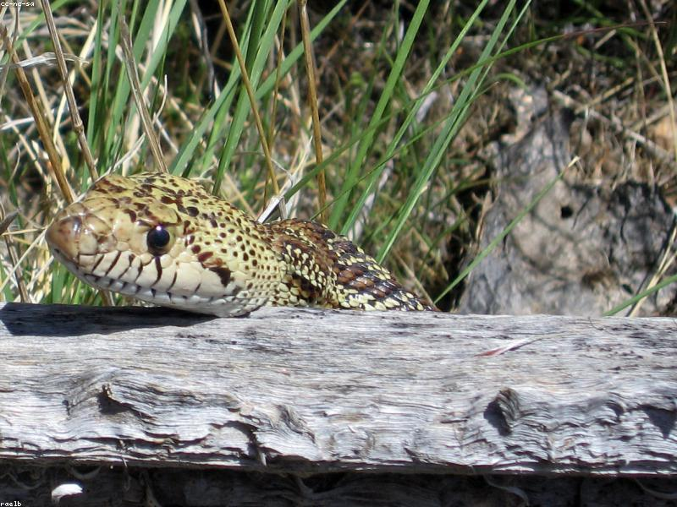
Gopher Snake
- The Gopher Snake is a non-venomous species that mimics rattlesnakes to deter predators.
- It is commonly found in North America, inhabiting a variety of environments including grasslands and deserts.

Slide 5
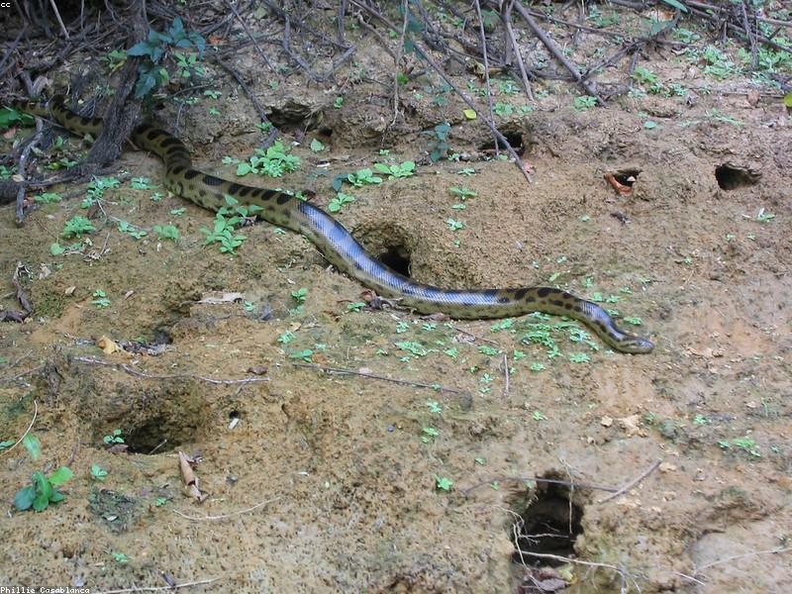
Anaconda
- The Anaconda is one of the largest snakes in the world by weight, primarily found in South America.
- It is an aquatic snake that can grow over 29 feet long and is known for its strength in constricting prey.

Slide 6
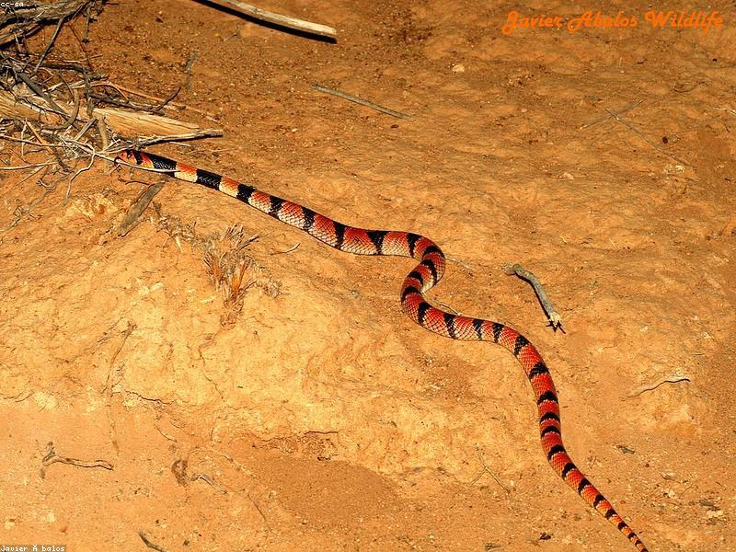
Coral Snake
- The Coral Snake is highly venomous and is recognized by its bright red, yellow, and black banding.
- It is often confused with non-venomous species due to its coloration, but it has a distinct pattern.

Slide 7
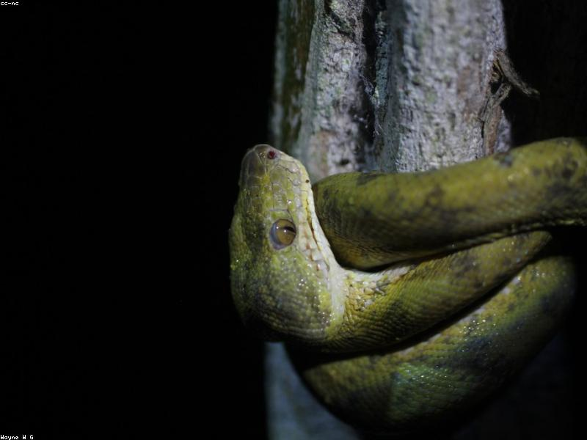
Boa Constrictor
- The Boa Constrictor is a large, non-venomous snake that kills its prey by constriction.
- It is found in a variety of habitats, including rainforests, savannas, and deserts.

Slide 8

Reticulated Python
- The Reticulated Python is one of the longest snake species, capable of reaching lengths over 20 feet.
- It is native to Southeast Asia and is known for its intricate color patterns.

Slide 9
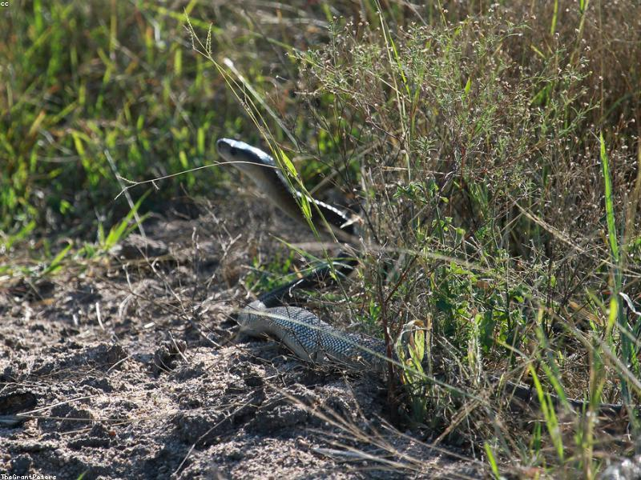
Black Mamba
- The Black Mamba is one of the fastest and most venomous snakes in the world, found in sub-Saharan Africa.
- It can move at speeds of up to 12 miles per hour and is known for its aggressive behavior when threatened.

Slide 10
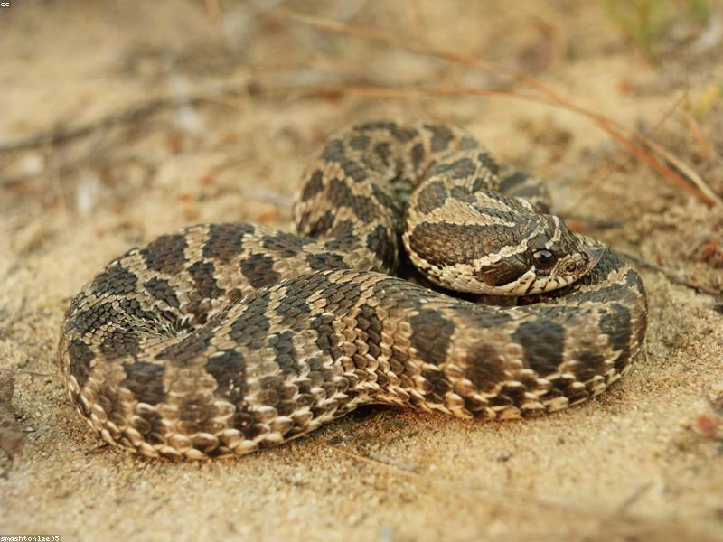
Hognose Snake
- The Hognose Snake is known for its upturned snout and unique defensive behavior, including playing dead.
- It is primarily found in North America and feeds on amphibians and small rodents.

